Slide 1

Expect Beyond

Slide 2

Expect Beyond
Merino Rationale
Expect Beyond Dimensions
The Brand name, Merino (IT Services), is derived from the parent company, Merino Industries. The logo symbolizes growth propelled by three important aspects people, processes and services. While the three arcs represent people, process and services, the green arrow is a sign of prosperity and growth.
The positioning ‘Expect Beyond’ came from the consumer’s insight which assures a complete bond between Merino and its clients.

Slide 3
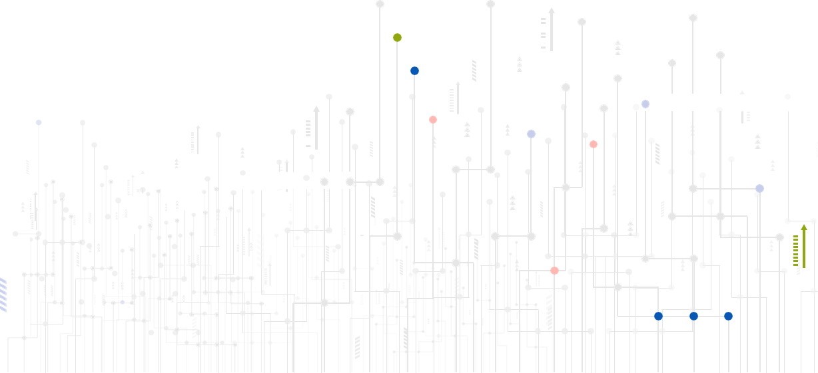

Consumer expectations drive us to do better.
When they want big, we create big enough.
Every new opportunity
comes wrapped in a new challenge.
Challenges are an inseparable part of our lives. We take the challenges head on, learn from them, and uncover the hidden opportunities lying inside.
From health-check to deployment
and then application management, a complete range of services help meet the varied needs of the businesses. Aside from that, we are creative enough to custom-design a solution depending on the need of the hour.
More than a decade has passed since we stepped into the arena of Information Technology. And since then, we have been analysing consumers, understanding their problems and making them believe in the reality of deploying technology solutions. Perhaps, we may not sound as appealing to our customers as an FMCG retailer, we exactly know what it takes to deploy Enterprise solutions. Furthermore, we understand what problems our customers go through and what they expect from us in response.
We take pride in making things a little easier for businesses, walking on our old school principles of eradicating challenges through PEOPLE, PROCESSES and
SERVICES. We make our customers count on us and
work round-the-clock to turn their expectations into reality – yep, that's exactly what we are so good at!
We are focused, with plenty
of experience under the belt.
13+ years of experience backed by some of the extraordinary minds help us meet even the toughest of the challenges that businesses face today. We sit together with our clients, share a cup of coffee, and go on to scrutinizing the possibilities of making a difference in their businesses.
Boundaries
cannot stop us.
Presence across multiple regions, 300+ clients - we have been helping global businesses for years whilst making a reputable place deep in their hearts. Having a keen eye for comprehending universal business problems, we think beyond the consumers’ expectations and provide them the best-in-class technology solutions.

Slide 4
About Merino Services
Merino Services, a global enterprise is part of a $250 million Merino Group, headquartered in India and has a strong presence in the USA, Canada, Europe, Middle East, South East Asia & India Subcontinent
The team consists of 200+ domain experts, serving 250+ clients across 41 countries
End-to-End service, ranging from Feasibility Study to Implementation of standard application to post implementation support along with AMS. We also add value to overall solution by designing & developing Mobility solutions
ISO 9001:2015 certified
GDPR Compliant

Slide 5

GLOBAL PRESENCE
Notes:
Portugal add

Slide 6
Merino Expertise
Services
Implementation and Consulting
Migration/Upgradation
Service and Support
Education and Training
Application Management
ERP Readiness and Health Checks
Solution
Enterprise Resource Planning
Customer Relationship Management
Enterprise Asset Management
Technology and Middleware
Enterprise Performance Management
Tecnology Alliance
Infor
Microsoft
IFS
Oracle
SAP

Slide 7
Merino’s Dual Advantage
VERTICAL SYSTEM INTEGRATION
Prediction, Simulation, CPS
Data Federation & Collaboration
Visualization, Monitoring, Analytics
Market to Order
Order to Cash
Idea to Offering
Forecast to Plan
CRM
SCM
Record to Report
Procure to Pay
ERP
Design to Build
Assess to Acquire
ERP
Operate to Maintain
Plan to Produce
PLM
EAM
HCM
Inspect to Quality
Acquire to Retire
HORIZONTAL BUSINESS PROCESS INTEGRATION
MOM / LMS - APS – MES - MI
PLC, SCADA, I/O Controllers, IIoT
Sensors, Actuators, RFID etc.

Slide 8

Services

Slide 9




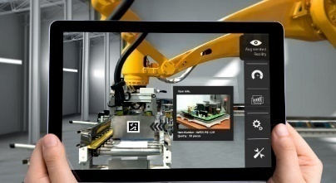
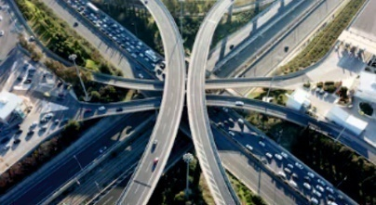


SERVICES OFFERINGS
Consulting Services
ERP Readiness and Health Check
ERP Implementation
Application Management Services
Manufacturing Excellence
Migration / Upgradation
Education & Training
Staff Augmentation

Slide 10

industries Focus

Slide 11












INDUSTRIES FOCUS
Equipment & Machinery
Discrete Manufacturing
Milling
(Metal, Paper & Plastic)
Automotive
High-tech Electronics
Food & Beverages
Textile
Aerospace & Defense
Distribution & Retail
Energy & Power
Ship Building
Wire & Cable

Slide 12







Did you know?
1700+
$38bn
Equipment rental revenue North America (ARA)
Association Membership
€23bn
Equipment rental revenue Europe(ERA)
AED ARA AEMP
Equipment Dealers, Service & Rental
20
9 CAT Dealers
60+
Years of Experience
Countries

Slide 13
Business challenges we see
Business Model & Technology Evolution
Service is King
Utilization of Equipment
Cost per Transaction
Evolving Environment
Internal Pressures

Slide 14
Business challenges we see
Manage the shift to rental and harness new technologies
Serve every customer uniquely
Maximize return on assets, service productivity & cut service WIP
Balance parts demand with Inventory investment and improve performance
Business Model & Technology Evolution
Service is King
Utilization of Equipment
Cost per Transaction

Slide 15
What if you could?
Manage the shift to rental and harness new technologies
Serve every customer uniquely
Maximize return on assets, service productivity & cut service WIP
Balance parts demand with Inventory investment and improve performance
Increased Competition
Changing Expectations
Shrinking Margins
Workforce Dynamics

Slide 16






And you also had?
Timely Information
Flexible Integration
Optimal Business Operations
Effective Collaboration
Efficient Processes
Location Flexibility
Lower TCO

Slide 17
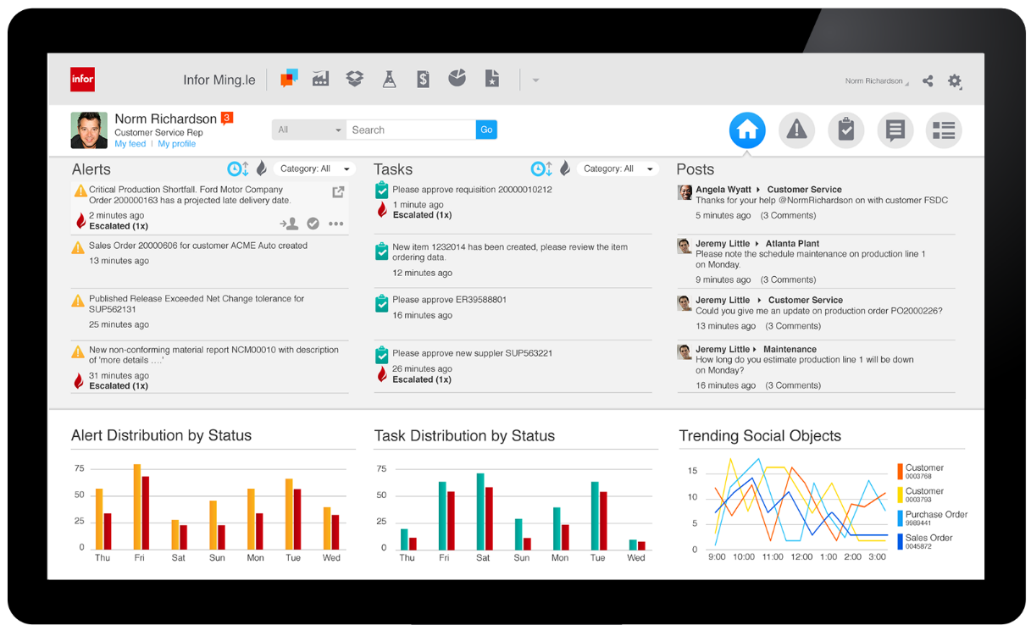
..and it looked like this?

Slide 18

Meeting your business challenges

Slide 19










Some Key Differentiators
One integrated solution – Dealers, Rental and Service
KPIs and analytics – built into the solution
Equipment CRM – a holistic view of all customer facing processes
Mobile, consumer-grade user experience - makes the field part of the office
Warranty and claim management with flexible warranty periods and types

Slide 20

Making innovation work for you

Slide 21

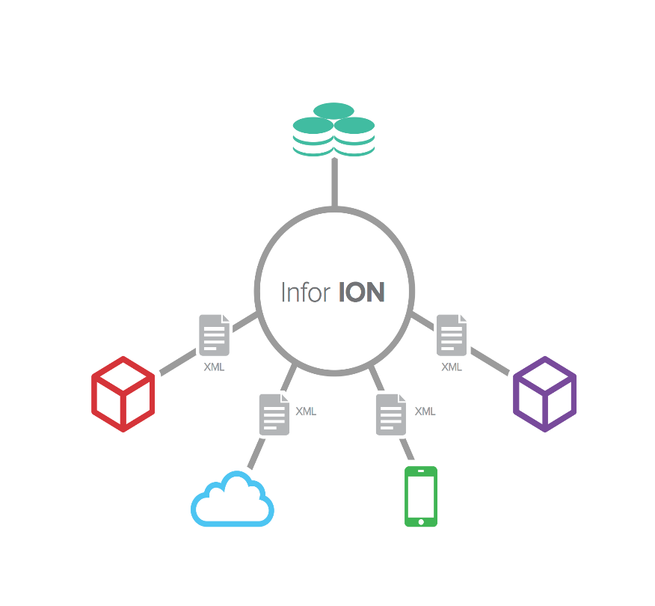
Business Vault
Analytics | Reporting | Search | In-context BI
Infor ION integrates a wide range of disparate systems, providing a simple but powerful framework for managing business process flows, workflows, and alerts.
The result is a unified data and business process platform that can reinvent the way end users and IT interact with core systems.
Application
Application
Cloud
Motion

Slide 22

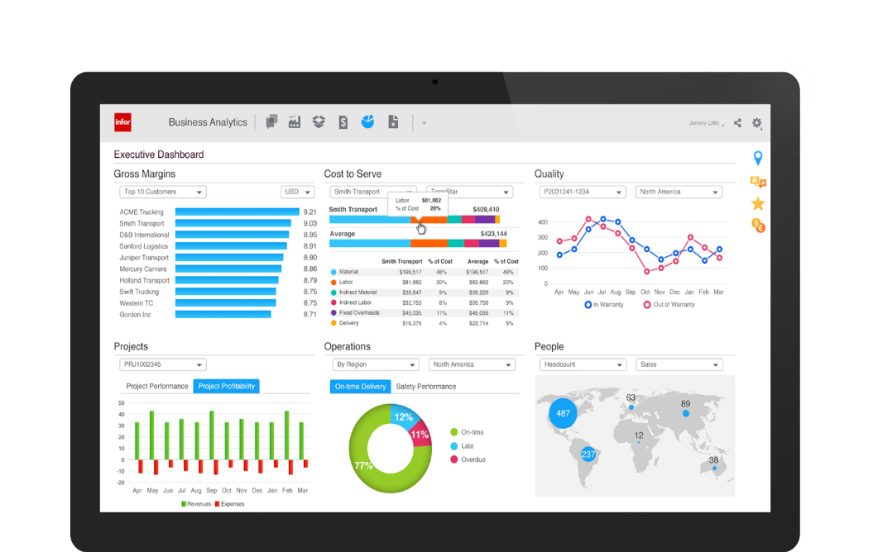
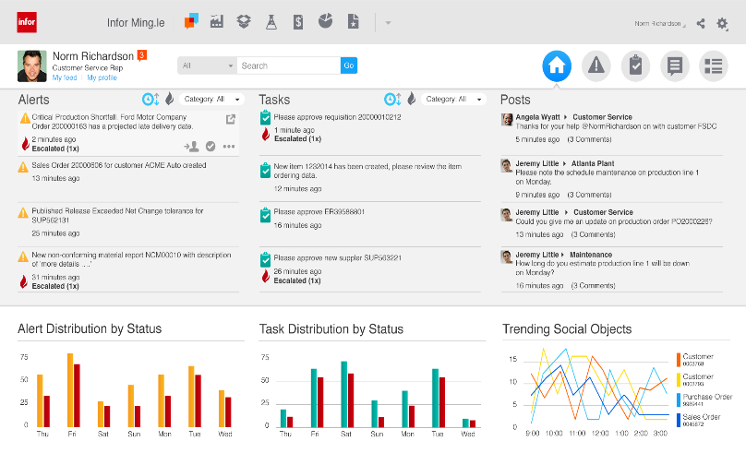
Social business?
Essential business.
Infor Ming.le makes collaboration natural and efficient.
Easy access to all systems
Stay connected with
real-time alerts
Communicate, collaborate and share information with colleagues
Automated tasks let you respond faster
In-context analytics deliver key indicators at a glance

Slide 23

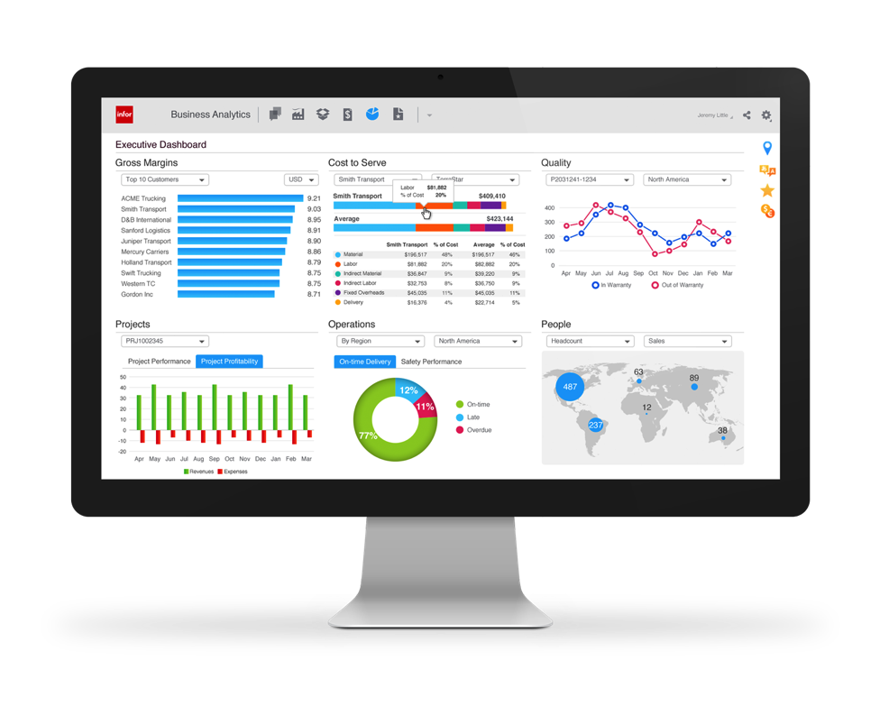


Bringing it all together
Complete Equipment suite
Deep core ERP Functionality plus vertical extensions for:
Equipment CRM
Analytics for Equipment
Demand Planning
Dynamic Enterprise Performance Management
Supply Chain Execution
Mobile Applications
Infor Ming.le™
Implementation
Accelerator
Mobile applications that increase response times and improve decision making for an agile workforce
Comprehensive solution for social collaboration, process improvement and contextual analytics
Industry business processes
pre-configured database & solution

Slide 24
Synopsis
We have precise solutions for your respective industry.
We figure out the strains in your industry.
Our innovative technology will accelerate your productivity and service.

Slide 25
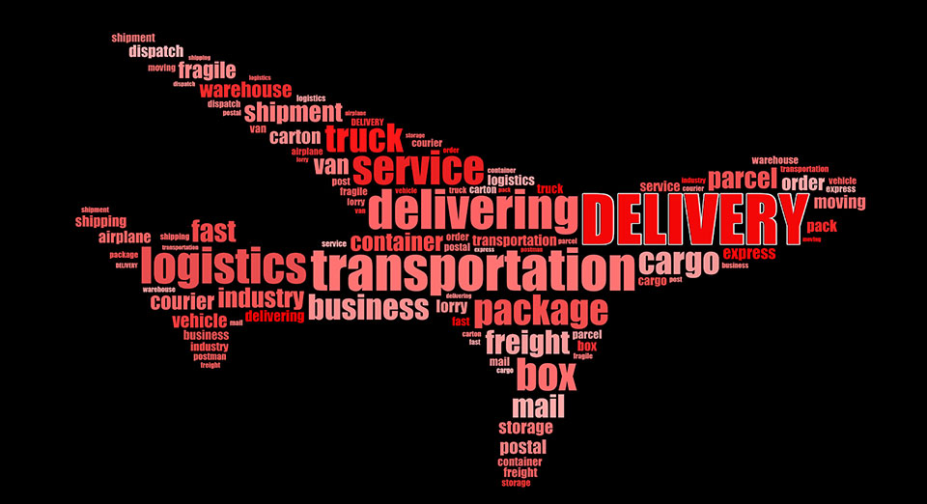
Delivery Model

Slide 26
DELIVERY MODEL
Onsite
offshore
hybrid
GLOBAL ENGAGEMENT MODEL
Proven Engagement Model for Delivering Reliable Solutions & Services across the globe
Local resources across the globe
On-demand Service & Support
ISO in various countries Certified, Tested and Delivered
On-site, Off-site, Off-shore and Near Shore delivery models
250+ skilled professionals serving customers
Application Managed Services

Slide 27

Why Merino
An Unbiased & Customer centric company

Slide 28








WHY MERINO
12+ years of rich experience handling vivid industries, distinguish complexities .
A complete technology solutions partner covering a comprehensive range of enterprise and IT solutions.
Having a manufacturing unit of our own, provides us with the essential know-how to guide businesses better.
Committed
Collaboration
Speed
Cost Efficient
Experience
Flexibility
Innovation
Global Offices

Slide 29

Thank you
Contact us:
Merino Services Limited
Corporate Office 70, KLJ Complex, Moti Nagar, New Delhi – 110015, India
+91 11 45068300
@
contact@merinoindia.com
INDIA USA EUROPE UAE SINGAPORE MALAYSIA INDONESIA

